Slide 1
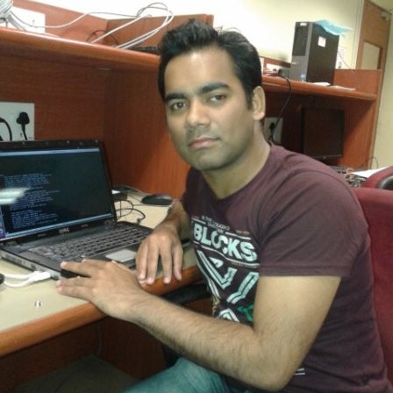

Functional Safety with Xen, Zephyr, and Linux
for Avionics, Automotive and Industrial
13 May 2026 7AM PT / 2PM UTC / 4PM CET
Matthew Weber
Associate Technical Fellow
Chief Software Architect Linux
Boeing
Ayan Kumar Halder
Sr. Member of Technical Staff
AMD

Slide 2
Agenda
Introduction, Xen Project, Xen FuSa – 5 mins
Key features of Xen – 5 mins
Key safety certification artifacts – 25 mins
How DO-178C complements ISO 26262 – 5 mins
Conclusion – 5 mins
Work in Progress - License: CC-BY-4.0

Slide 3
Xen Project
Key contributors to Xen Project includes:
SUSE
XenServer
AMD
Arm
Vates
AWS
Boeing
EPAM
Ford
Honda
Invisible Things Lab
Renesas
The Xen Project team is a global Open Source community that develops the Xen Project Hypervisor and its associated subprojects.
The various subprojects include hypervisor, XAPI, XCP-NG, Windows PV drivers, etc.
Cloud
Server
Security
Embedded
Work in Progress - License: CC-BY-4.0

Slide 4
Xen Functional Safety Group
A group of companies who wants to steer Xen towards safety certification
Key contributors include:
AMD
Arm
Boeing
Bugseng
EPAM
Ford
Parrylabs
Renesas
Resiltech
Meetings on every alternate Tuesday at 16:00 CET
https://wiki.xenproject.org/wiki/FuSa_SIG/Meetings

Slide 5



The Xen Functional Safety vision
IEC 61508
The key aspects of any functional safety certification are requirements, architecture specifications and tests.
Requirements,
Architecture Specifications,
Tests
DO 178
ISO 26262
Work in Progress - License: CC-BY-4.0

Slide 6
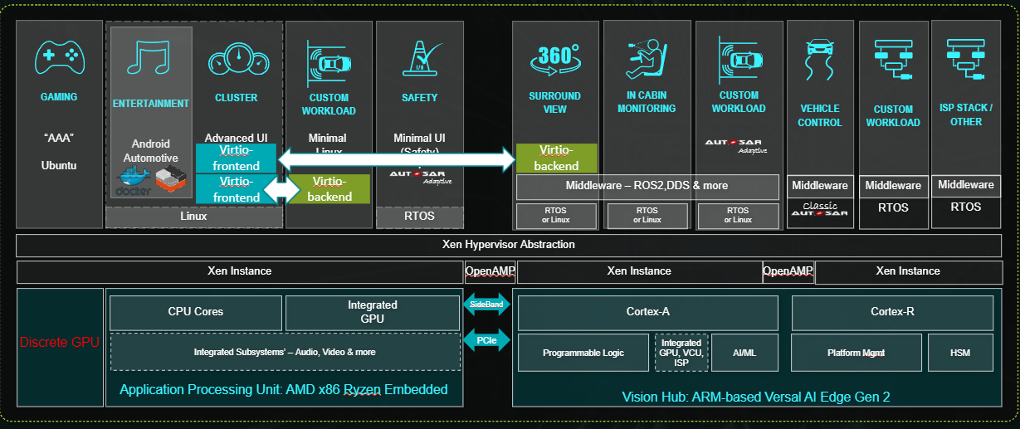


Using Xen as a Unified Runtime Manager
GAMING
“AAA”
Ubuntu
CLUSTER
Advanced UI
CUSTOM
WORKLOAD
Minimal
Linux
SAFETY
Minimal UI
(Safety)
+
SURROUND VIEW
IN CABIN
MONITORING
CUSTOM WORKLOAD
VEHICLE CONTROL
CUSTOM WORKLOAD
ISP STACK / OTHER
ENTERTAINMENT
Android Automotive
Virtio-frontend
Virtio-backend
Adaptive
Virtio-frontend
Virtio-backend
Adaptive
Middleware – ROS2,DDS & more
Middleware
Middleware
Classic
RTOS
RTOS
Middleware
Linux
RTOS
RTOS
or Linux
RTOS
or Linux
RTOS
or Linux
Xen Hypervisor Abstraction
Xen Instance
OpenAMP
Xen Instance
OpenAMP
Xen Instance
Discrete GPU
Application Processing Unit: AMD x86 Ryzen Embedded
SideBand
Vision Hub: ARM-based Versal AI Edge Gen 2
CPU Cores
Integrated
GPU
Cortex-A
Cortex-R
Integrated Subsystems’ – Audio, Video & more
PCIe
Programmable Logic
Integrated
GPU, VCU, ISP
AI/ML
Platform Mgmt
HSM
A Common Hypervisor Layer across Clusters

Slide 7
The Xen Functional safety vision
Xen is a Safety Element Out Of Context.
It defines the assumptions on the surrounding components (firmware, bootloader, VM, hardware)
Firmware, bootloader, hardware can have safety integrity level greater than or equal to that of Xen
VM1, VM2 can have safety integrity level less than or equal to that of Xen
VM1 and VM2 can be of different safety integrity levels.
VM1, VM2 can be Linux , Zephyr, etc.
VM1
VM2
Freedom from interference
Safety certified Xen
Firmware
Bootloader
Hardware
Work in Progress - License: CC-BY-4.0

Slide 8
Key Features of Xen hypervisor for functional safety
Type 1 hypervisor (reduced SLoC and a clean isolation from VMs)
Domain roles and property
Linux, Zephyr
Support for Memory Protection Unit (Arm real time processors)
Fine granular configs

Slide 9
Key Features of Xen for safety certification
Type1 hypervisor (Or Baremetal Hypervisor)
Xen manages few hardware resources like Interrupt controller, IOMMU, Timer, UART, MMU
Static partitioning of memory and hardware resources to VMs. Ensures that the other VM will not have access to the device and memory
Xen can create and boot domains in parallel (Hyperlaunch). There is no need for Dom0 to create other domains
Supports Arm safety cores and IPs: Cortex-A720AE, GIC-600AE, MMU-600AE
App1
App2
App1
App1
EL0
VM1
VMn
EL1
Safety certified Xen
EL2
Firmware
EL3
Hardware

Slide 10
Xen with Zephyr and Linux as VMs
Preferably safety cert RTOS. Very minimal functionality
A rich OS which has support for many drivers
Minimal OS which can be interrupted by other domains
Minimal OS which cannot be interrupted by other domains
There can be 0-1 control domain and/or 0-1 hardware domain and/or 0-N targetable/untargetable domains
Xen supports both static mapped domains created at boot time and dynamic domain created at run time.
Control domain - Zephyr
Hardware domain - Linux
Targetable regular domain – Zephyr
Untargetable regular domain - Zephyr
Safety certified Xen – ASIL D / SIL3
Arm Trusted Firmware
Hardware

Slide 11
Domain capabilities and properties
Control domain
Regular domains
Can be assigned one or more hardware
suspend/resume, pause/unpause,
Shutdown/restart
Impacts the platform
*Default owner of the platform unless a device is assigned to another domain
Hardware domain
Platform specific operations
The control domain can be a safety cert RTOS like Zephyr
The hardware domain can be a rich OS which supports many drivers like Linux
Untargetable
Regular domains

Slide 12
Assumptions on domains
Control domain
Has the toolstack to create/destroy domains at runtime.
Can run privileged operations to impact other domains (via mapping memory, etc)
Should be untargetable
Hardware domain
Can be a part of control domain (ie dom0) or separate.
Able to support all the platform devices
Can run device emulation (backend)
Should be targetable
Regular domain
Can be assigned one or more platform devices.
Can share devices using PV or VirtIO with other domains.
Can be targetable (for PV/VirtIO) or untargetable

Slide 13
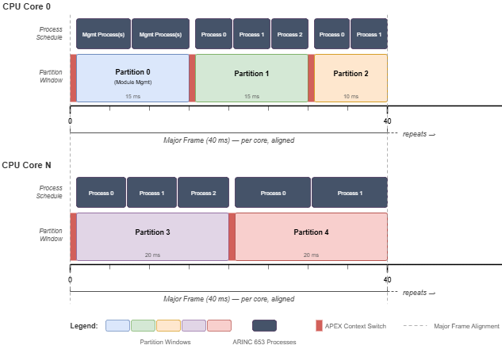
Scheduler
Xen supports multiple schedulers: (RTDS not shown)
NULL – static pinning
ARINC653
pCPU
pCPU
vCPU
vCPU
Credit2
pCPU
pCPU
vCPU
vCPU
vCPU
vCPU
(Partition == Domain)

Slide 14
MPU (Armv8-R) support
The Memory Protection Unit defines protection regions in the address map​
The MPU address translation is the process of flat mapping VA to PA​
A protection region is defined by:​
A base address​
A limit address​
A set of access permissions and memory attributes​
A protection region has a minimum size of 64B
The architecture allows maximum 255 regions.
MPU is supported in Zephyr, Qemu. Xen is WIP
Pure static configuration
Zephyr as domU with device1 assigned
(EL1 – MPU)
Zephyr as domU with device 2 assigned
(EL1 – MPU)
Xen V8R
pCPU
pCPU
Qemu V8R
https://patchew.org/Xen/20260408135531.1744388-1-luca.fancellu@arm.com/

Slide 15
MISRA C adoption
Directives 1.1, 2.1, 4.1, 4.7, 4.10, 4.11, 4.14 adopted
120 MISRA C rules adopted
https://gitlab.com/xen-project/xen/-/blob/staging/docs/misra/rules.rst?ref_type=heads
Violations are fixed. Unfixed violations are documented
https://gitlab.com/xen-project/xen/-/blob/staging/docs/misra/documenting-violations.rst?ref_type=heads
ÉCLAIR MISRA C scanner used in upstream CI loop.
Every patch submission goes through the MISRA C scans to avoid regressions.
Contributors from Bugseng, AMD, EPAM, Cloud, SUSE are actively fixing violations in the upstream Xen for arm64 and x86 platforms.
C language extensions and the assumptions on the toolchain (GCC) are documented
https://gitlab.com/xen-project/xen/-/blob/staging/docs/misra/C-language-toolchain.rst

Slide 16
Key safety certification artifacts
Requirements
Requirements are written as per NASA format.
Architecture specs
Tests
Traceability report using openfasttrace

Slide 17
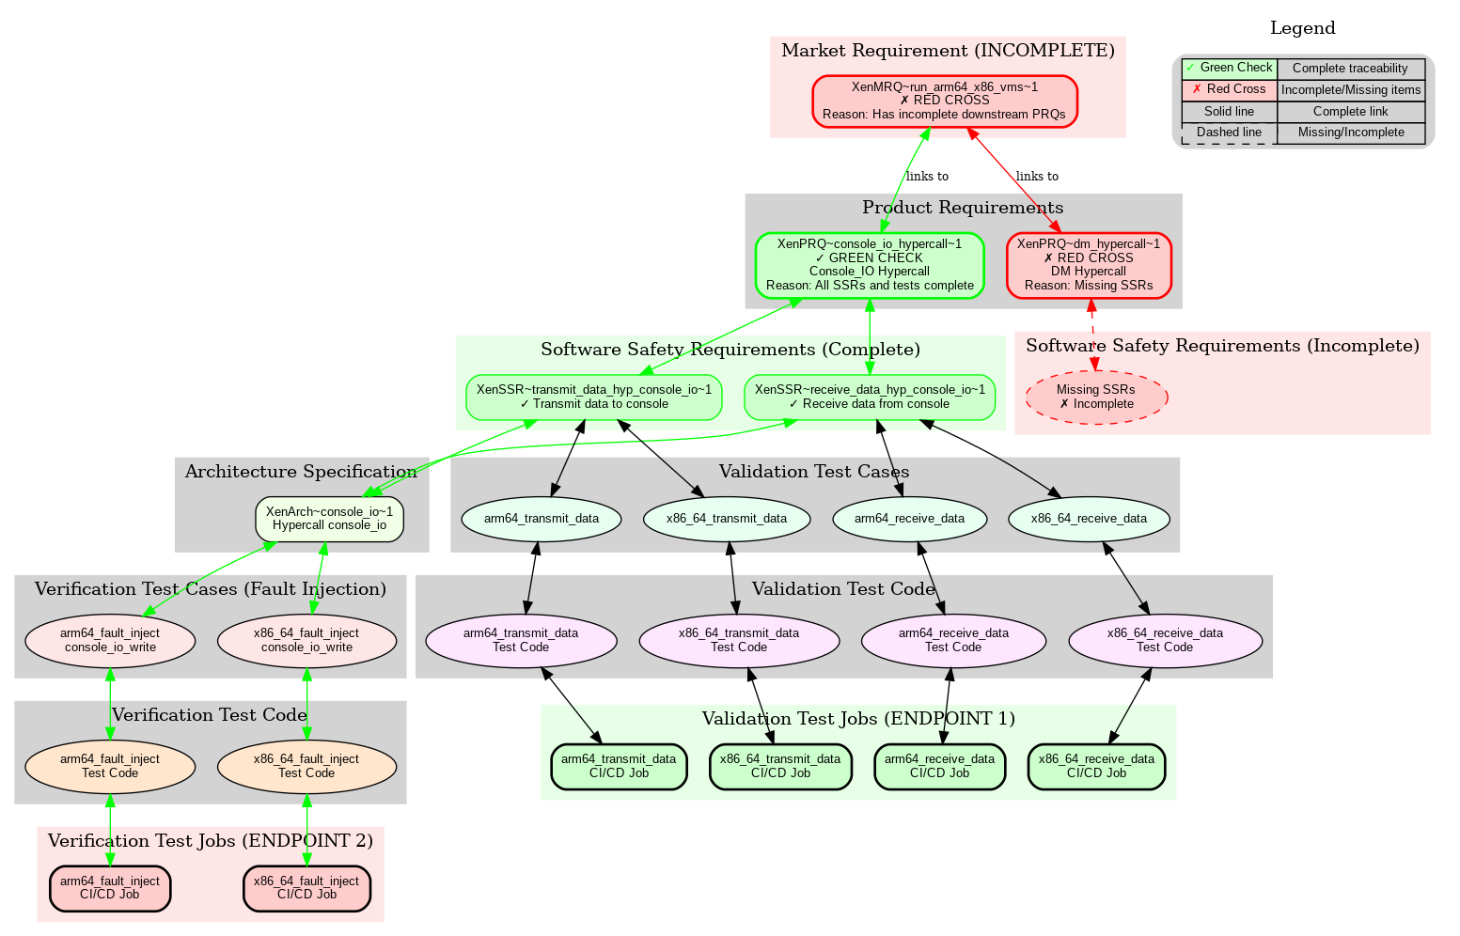
Key Safety certification artifacts
Notes:
End to end bidirectional traceability.

Slide 18
Market Requirements
Identify the scope of the safety certification for Xen
Defines the expectations of Xen for automotive and embedded use cases
So, this is mostly of interest to the product marketing or FAE who have expectations from a hypervisor.
Written with a high-level view of the system
Example:
Name | Description
Static VM definition | Xen shall specify the resources required to boot and run safe and non-safe VMs.
Run Arm64 and AMD-x86 VMs | Xen shall run Arm64 and AMD x86 VMs.
VM device assignment | Xen shall assign devices to each VM. For e.g.: it should be able to assign GPU to VM1, MMC to VM2. Only the VM assigned to a device shall have exclusive access to the device.

Slide 19
Product Requirements
Product Requirements explain how Market Requirements are fulfilled by Xen
Product Requirements are Xen specific
So, this of interest to Xen architects who understand how the requirements are fulfilled by Xen.
Still written with a high-level view of the system
Product Requirements can sometimes be linked to more than one Market Requirement
Run ARM and AMD x86 VMs
Emulated UART
Xen shall emulate UART on behalf of the domains.
Emulated Timer
Xen shall emulate timer on behalf of domains.

Slide 20
1 Product Requirements 🡪 N Software Safety Requirements
Emulated Timer
Probe the Generic Timer device tree node from a domain
Xen shall generate a device tree node for the Generic Timer (in accordance to ARM architected timer device tree binding [2]) to allow domains to probe it.
Read system counter frequency
Xen shall enable domain to read the frequency of the system counter (either via CNTFRQ_EL0 register or "clock-frequency" device tree property if present).
Access virtual timer from a domain
Xen shall enable domain to access and make use of the virtual timer by accessing the following system registers: CNTVCT_EL0, CNTV_CTL_EL0, CNTV_CVAL_EL0, CNTV_TVAL_EL0.
Trigger the physical timer interrupt from a domain
Xen shall enable domain to program the physical timer to generate the interrupt when the asserted condition is met.
Trigger the virtual timer interrupt from a domain
Xen shall enable domain to program the virtual timer to generate the interrupt when the asserted condition is met.

Slide 21
Characteristics of Software Safety Requirements
The requirements are written in plain English, from the perspective of what Xen is expected to fulfil
The software safety requirements (SSR) are expected to be the most granular form
Engineers are expected to refer to a SSR (and architecture spec) to write a test to validate it
This is of interest to the subsystem maintainers or folks working on specific parts of Xen (eg generic timer).
Each SSR should be tested independently
SSR should be unambiguous, complete, consistent, correct
SSR should be traceable all the way to market requirements

Slide 22
Organizing the software safety requirements
Domain Creation
Domain Firmware
Booting
Domain Fully Emulated
Instruction emulation
Firmware
Domain Exposed
Xen Internals
Domain Partially Emulated
Physical resources
Physical resources
Hypercall
Scheduling
FFI
Upstreamed - ~60 requirements
In flight - ~400 requirements

Slide 23
Assumption of Use
The hardware needs to have the ARM Generic Interrupt Controller, version 3
The hardware needs to have the Arm System Memory Management Unit, version 3 onwards
Hardware
CNTFRQ_EL0 needs to be programmed with the system timer frequency. Or the "clock-frequency" dt property should be used.
TF-A shall provide PSCI api (PSCI_VERSION) to read the version.
GCC version shall be 5.1 or later (arm64)
GCC version shall be 4.1.2_20070115 or later (x86)
Arm Compiler for Embedded FuSa (based on LLVM 22.1)
Compiler
Firmware
Xen relies on them to fulfill its functionality
Domain shall not write access GICD_ISACTIVER<n> registers
Domain shall not use physical LPIs without ITS
Domain
Bootloader
Xen shall be loaded at Non-Secure EL2 exception level.
Bootloader shall pass physical address of the host device tree in x0 register.
DDR shall be initialized, DMA devices shall be stopped
Notes:
Artem to add safety compiler

Slide 24
Key Assumption of Use on Domains
On Zephyr as safety critical domain – It should mask its event channel notifications during the safety critical task to avoid being interrupted by other domains
On Linux as QM domain – It shall enable the platform devices and perform platform operations (suspend, power off, reset, reboot) only when requested by the control domain.
It shall enable the PV.VirtIO backend drivers to perform device emulation

Slide 25
Architecture Spec
While requirements describe the features that Xen provides, architecture spec describes how the feature is implemented, interfaces to the other architectural components, error propagation, data/control flow, etc
Architecture Spec is linked to a set SSRs belonging to a component
By linking SSRs to Arch spec , we avoid putting any markers in the code (and thereby ensure the code is clean).
https://gitlab.com/xen-project/fusa/architecture_specs/-/blob/master/domain_creation_and_runtime/domain_partially_emulated_resources/arm64/generic_timer.rst

Slide 26
Tests
Tests are needed to verify the requirements or architecture specifications
Domain based tests
HW/SW integration Tests
GDB based tests for internal interface
Hardware Fault injection
Fuzzing

Slide 27
Overall Testing deployment
Fuzz
Domain based validation tests or domain/Xen interface tests
Domain based validation tests or domain/Xen interface tests
Domain based fault injection tests to Xen or negative tests
Runtime tests/ memory stress tests
FFI tests
Internal interface tests
Xen ASIL D (SEooC)
Mem alloc
Scheduler
Trap handler
Xen/Bootloader/Firmware interface tests
Xen/hardware interface tests
DTB/Firmware/Bootloader fault injection tests
Hardware based fault injection
Qemu/Hardware
Notes:
Qemu is the preferred approach for hw fault injection.

Slide 28
Domain based Tests/SSR tests/Xen domain interface
Domain based tests are used to verify the blackbox requirements or perform fault injection from domain
For eg - Xen shall support transmission of data in polling mode for the domain.
Pros - Xen is unmodified. It is tested in the way it will be used in production.
Cons - The tests are relatively high level. They can test a lot of code together.
Emulated UART
Trap/Exception
handler
Linux/Zephyr/XTF as domain
with UART driver and application
Xen

Slide 29
Xen/HW interface Test
The test aims to validate Xen’s configuration of the hardware. For eg Xen’s GICv3 driver should be able to generate software generated interrupt
For this, we introduce self tests within Xen.
https://gitlab.com/xen-project/fusa/test_specifications/-/blob/master/hw_sw_interface/test0_sgi_gicv3.rst
https://lists.xenproject.org/archives/html/xen-devel/2025-09/msg00956.html
Xen
The test can be compiled out in the production build
The test runs during boot time
GICv3 driver
GICv3 Test

Slide 30
Internal Interface Testing
To validate a complex Xen logic at runtime. The test is controlling the execution flow directly through a debugger
Execution Model:
QEMU: Launches Xen and immediately freezes it at the first instruction, preventing execution
GDB/LLDB: Connects to the waiting QEMU instance, loads Xen's symbols (xen-syms) for full kernel visibility and takes complete control
Python Script: An automation script running inside the debugger drives the entire test scenario, setting breakpoints, manipulating execution and inspecting the system state to determine the outcome
Controlling Flow: Setting breakpoints in critical functions to pause execution at key moments
Manipulating Execution: Actively modifying the program's behavior:
Success Path: Allowing normal execution while inspecting function arguments, return values and internal data structures to ensure correctness
Failure Path/Fault Injection: Forcing a function to return an error code to test the system error-handling paths
Inspecting & Validating State:
Assertions are performed inside the debugger context
The final verdict ('SUCCESS'/'FAIL') is based on the observed kernel state
Notes:
Keep this

Slide 31
GDB based tests for internal interface
Xen has lots of internal components which invoke one other. We need a way to test the interface between the components. Also, we need a way to inspect the internal data structure and mock the error handling paths.
Use GDB to validate the internal data structures or the interface between different arch components
https://gitlab.com/xen-project/fusa/test_specifications/-/blob/master/domain_creation_and_runtime/scheduling/test_sched_core_halt_on_scheduler_failure.rst
Xen
Credit2 scheduler
Core scheduler subsystem
GDB to inspect return values and modify to simulate failures

Slide 32
Hardware Fault Injection using Qemu
Using Qemu testing framework
Xen
GICv3 driver
Xen panics
Inject fault
Qemu
QTest
GICv3 hardware
Qemu can emulate most of the hardware faults which are observed by Xen
It emulates many of AE IPs which have test registers
Notes:
Move after the QnA

Slide 33
Software fault injection/negative tests
Using domains, device tree binaries, etc
Xen
Invokes hypercall with incorrect params or performs an illegal action
Domain
Returns error or takes appropriate action
Xen
Some of the fault injection tests are derived from boundary value analysis/equivalence class partition of hypercall parameters
Xen stops booting
Improper HW configuration in device tree

Slide 34
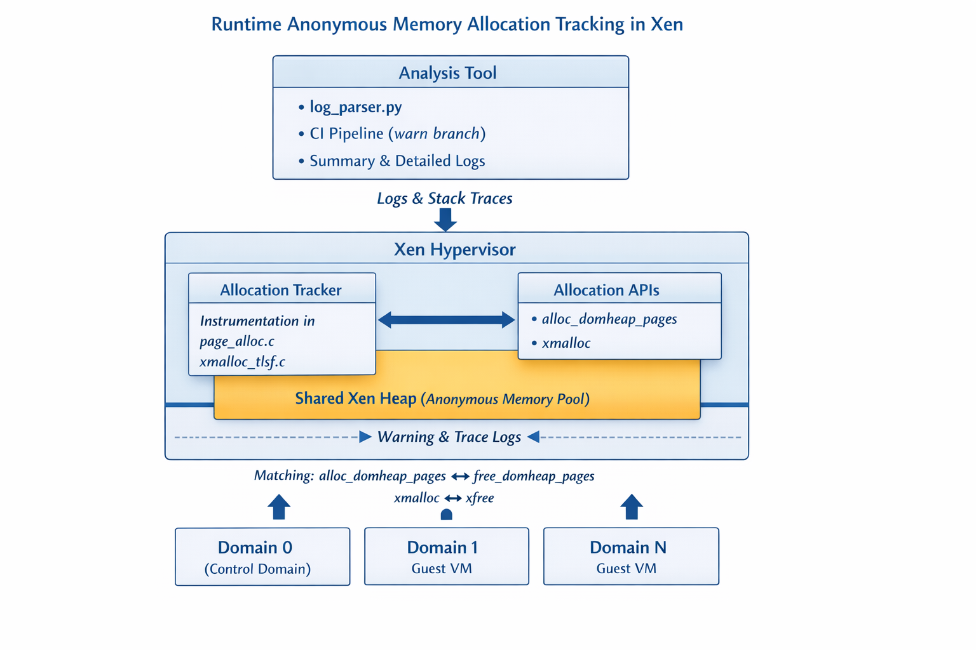
Runtime tests
Minimise the runtime memory allocation. To prevent Xen from running out of memory
Xen has a shared heap → source of anonymous allocations
Domains (d0, d1, …) trigger allocations indirectly via Xen
Tool instruments core allocators (TLSF + page allocator)
Runtime → after SYS_STATE_active (post-boot steady state)
Output → logs + stack traces + domain attribution + matching frees
https://gitlab.com/minervasys/public/xen/-/blob/minerva/warn/minerva_analysis/README.md
Notes:
Move after conclusion

Slide 35
Fuzzing Test
Generate inputs​
Pass inputs to software under test (SUT)​
Collect feedback​
Mutate inputs based on feedback​
Repeat from step 2
Uses:
Domain-based testing
HW/SW interface testing
Internal interface testing
Fault injection

Slide 36
The missing puzzle
Space and time partitioning
Defining a FuSa system use case
EL1 stage 2 (P2M) for VM1
EL1 stage 2 (P2M) for VM2
EL1 stage 2 (P2M) for VM3
QM VM
Safe VM
Mixed VM
Testing for isolation between the VMs partitioning in Xen
Time slot
Time slot
Time slot
FuSa XEN
FuSa Xen (SIL-3/ASIL-D/mixed)
EL2 mapping for Xen
FuSa Firmware/bootloader
FuSa hardware
Stay tuned to see how DO-178 addresses these challenges

Slide 37
How DO-178C complements ISO 26262

Slide 38
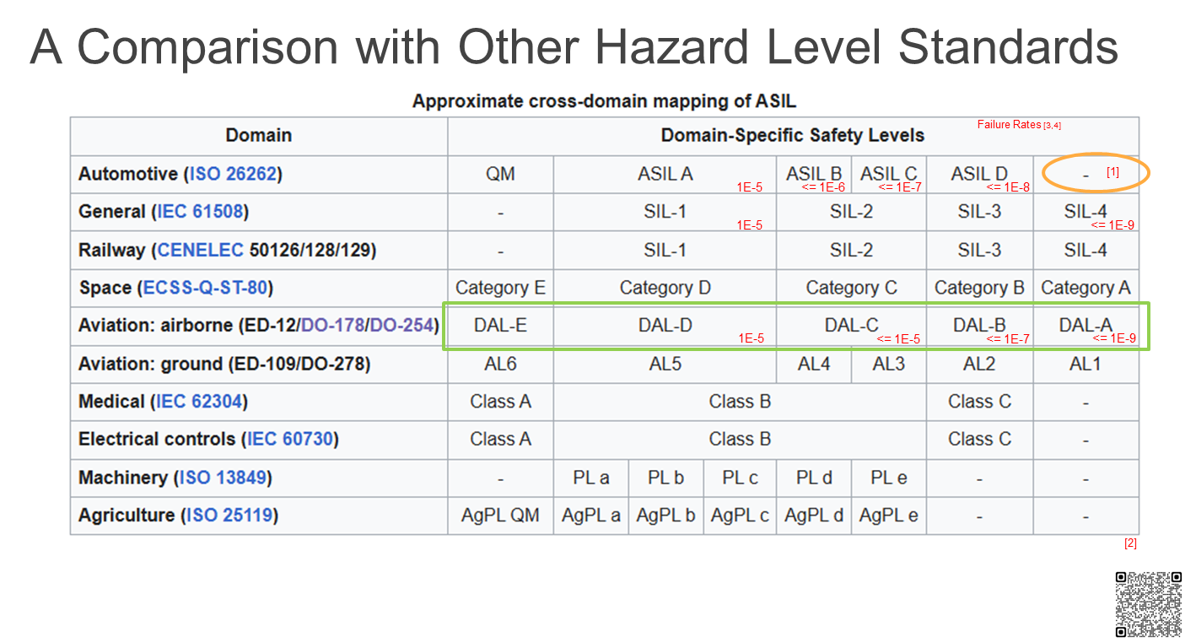
Military (MIL-STD-882E), “Level of Rigor”
NASA (NPR 7150.2), “Class”
[1] https://www.rapitasystems.com/blog/whats-difference-between-sil-and-dal-how-does-it-affect-my-code-coverage
[2] https://en.wikipedia.org/wiki/Automotive_Safety_Integrity_Level#Comparison_with_Other_Hazard_Level_Standards
[3] https://www.rapitasystems.com/do178c-testing (DO-178C Failure Rate)
[4] https://en.wikipedia.org/wiki/IEC_61508#Probabilistic_analysis (SIL Failure Rate)

Slide 39
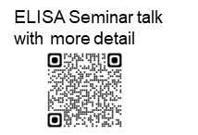
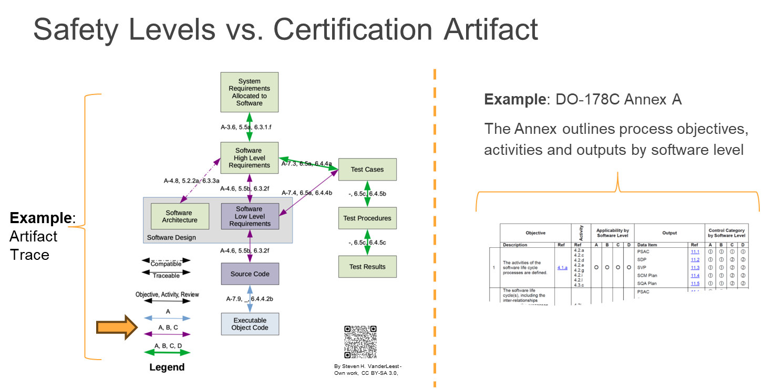
(DO-178C)
System level == DAL
(Design Assurance Level)
SoftWare Level == SWL
(SWL)
By Steven H. VanderLeest - Own work, CC BY-SA 3.0, https://commons.wikimedia.org/w/index.php?curid=27610716
Table example - https://www.parasoft.com/learning-center/do-178c/what-is/

Slide 40

How DO-178C complements the ISO/IEC effort
DO-178C targets a lower failure rate @SWL-A(<=E-9) vs ASIL-D(<=E-8)
Low level requirements → traced to safety/design requirements + code
Unit testing w/ mocking for full Equivalence class(s) and Boundary value analysis
E.g., test the most critical parts (e.g., page table mapping, timer)
Standardized safety computing https://en.wikipedia.org/wiki/ARINC#Standards
“Avionics Application Software Standard Interface“ https://en.wikipedia.org/wiki/ARINC_653 for the operating environment. See “ARINC 653 hypervisor” ref on the linked page for details.)
“Integrated Modular Avionics(IMA)” DO-297 - System level guidance for mixed safety-criticality - https://en.wikipedia.org/wiki/DO-297
Overlap in safety-related tooling (e.g., coverage/coupling, safety compiler)

Slide 41

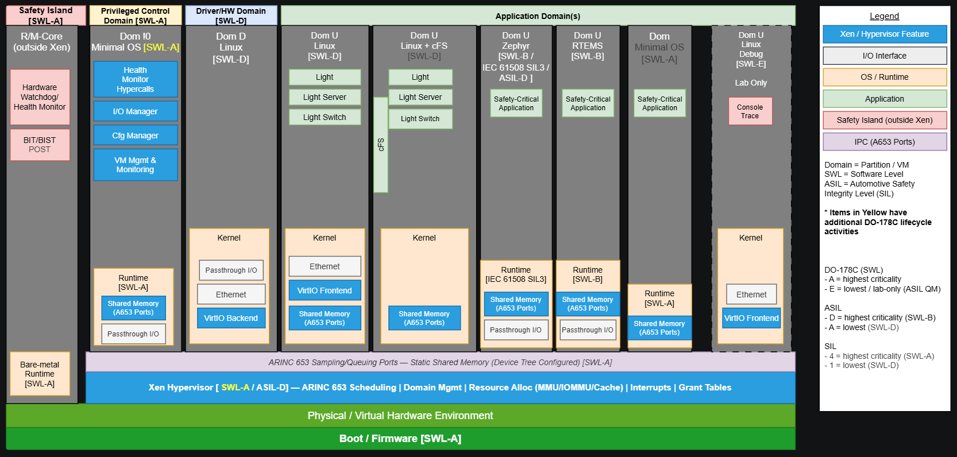
ELISA DO-178C safety vision
ELISA June 2026 workshop
(Draft: Example of mixed safety levels or “mixed criticality”)
https://github.com/elisa-tech/wg-aerospace/pull/177/changes

Slide 42
Conclusion

Slide 43
Keeping safety cert evergreen (Loud thinking)
Upstreaming requirements, arch specs and tests
Onboarding new maintainers for the safety artifacts
Code maintainers should not be overburdened
Keeping the code as pristine as possible.
Lightweight QMS process
Cert credit
Join us at Xen summit where we align our safety efforts with the wider Xen community
Fusa
Reqs
Arch specs
Tests
Upstream Xen.git
Xen FuSa
(staging repo)
To help with upstreaming and show the FuSa dependencies

Slide 44

Collaboration
To develop an open source, upstream safe hypervisor requires a lot of community effort
Join xen-devel mailing list – All discussion. Reviews happen on the mailing list
Join Xen Functional Safety matrix channel
Calls every other Tuesday for members actively working on FuSa

Slide 45
Thanks and Questions. (15 mins)

Slide 46
Ayan to do
URLs to xen-devel, xen-project, QR code on each slide
Linux/Zephyr collaboration
Grammer, fonts, diagrams check

Slide 47
Additional slides

Slide 48
Non blocking virtIO
Traditionally
The regular domain is blocked until the hardware domain returns a response.
Control domain - Zephyr
Hardware domain – VirtIO backend
Targetable regular domain – VirtIO frontend
Non blocking virtIO allows the communication to be asynchronous
Device emulation using Qemu
IO request to the backkend
Safety certified Xen – ASIL D / SIL3
Forwards the

Slide 49
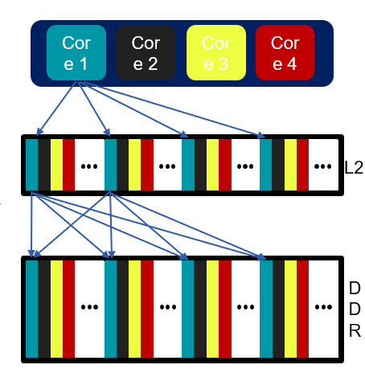
Real Time - Cache coloring
CPUs clusters often share L2 cache
Interference via L2 cache affects performance
App0 running on CPU0 can cause cache entries evictions, which affect App1 running on CPU1
App1 running on CPU1 could miss a deadline due to App0’s behavior
It can happen between Apps running on the same OS & between VMs on the same hypervisor
Hypervisor Solution: Cache Partitioning, AKA Cache Coloring
Each VM gets its own allocation of cache entries
No shared cache entries between VMs
Allows real-time apps to run with deterministic IRQ latency

Slide 50
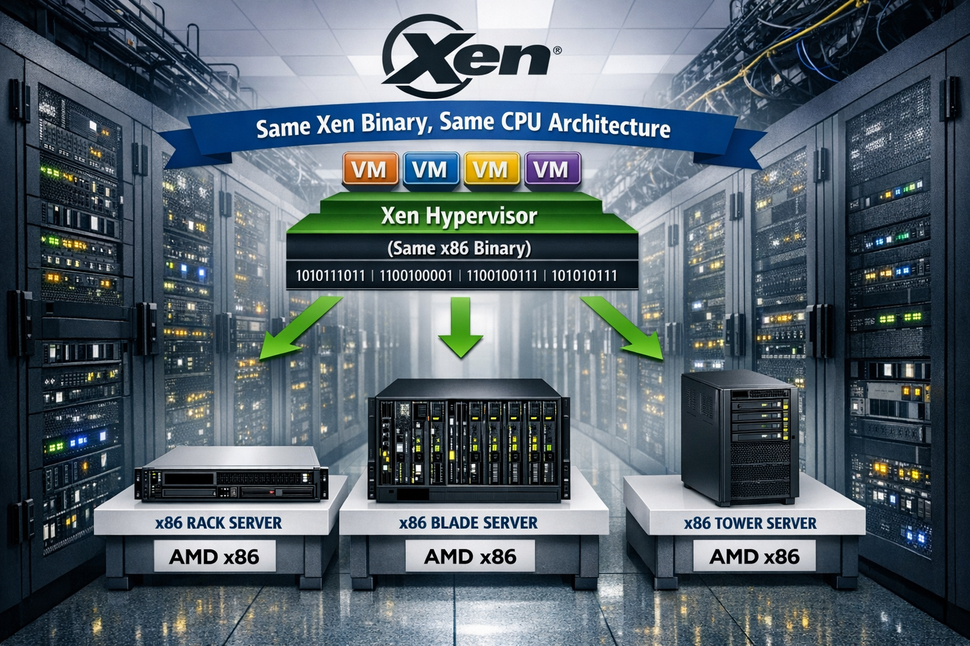
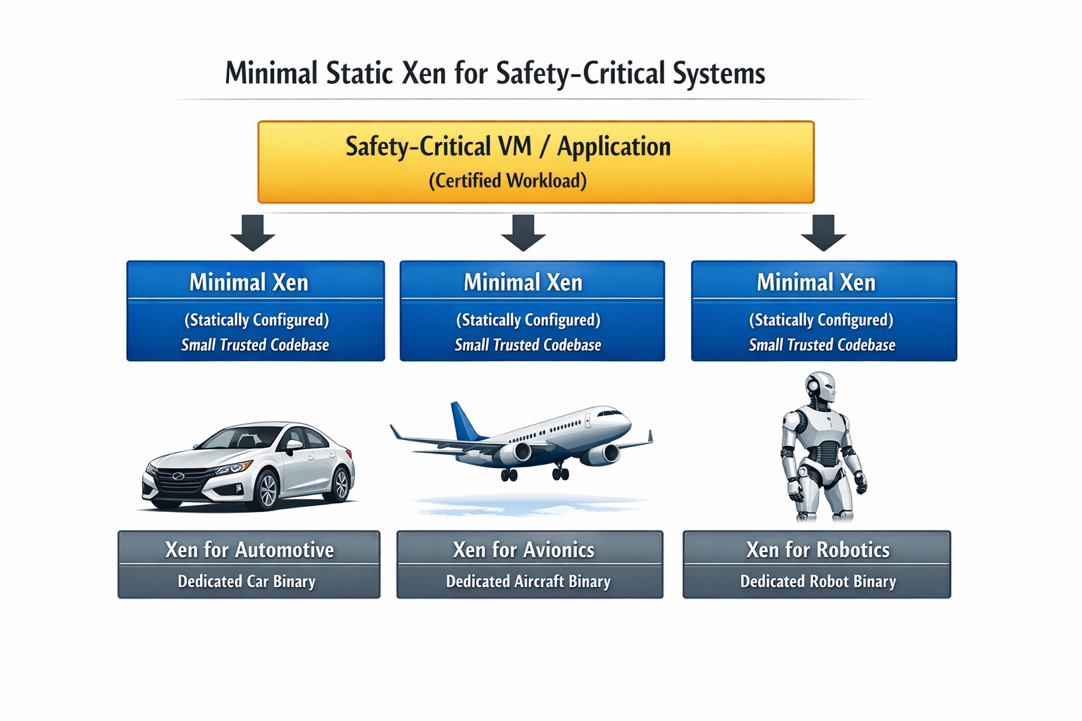
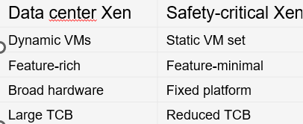
Fine Granular configs to reduce SLoC
Add configs to eliminate code related to unsupported hardware features
GICv3 NR_LRS
GICv3 Num of priorities
https://patchew.org/Xen/20260318140900.3795710-1-ayan.kumar.halder@amd.com/
Notes:
Move to the conclusion after QnA

Slide 51
LibAFL + QEMU​
QEMU provides "snapshot" feature which allows us tighten main loop, as no reboots are needed:​
​Spawn QEMU​
Boot SUT (Xen + XTF test harness in our case)​
Test harness requests test input. At this point snapshot is created​
Fuzzer provides input to the test harness​
Input is passed to Xen. Code coverage is measured​
Test harness submits test result (fail/no fail) + code coverage data to the fuzzer​
Fuzzer prepares new input and restores snapshot at p.3​
This makes fuzzing faster as it eliminates boot times (steps 1-3)​

Slide 52
Structured fuzzing​
The simplest type of input is homogenous byte buffer without internal structure. We hope that fuzzer will determine structure by itself. Works surprisingly well (we even found some crashes using this technique)​
Structured fuzzing: fuzzer is aware of internal structure of a request, which allows it to submit more valid requests and mutate them in a meaningful way:​
struct evtchn_bind_interdomain {
/* IN parameters. */
domid_t remote_dom;
evtchn_port_t remote_port;
/* OUT parameters. */
evtchn_port_t local_port;
};
For example, fuzzer can target specifically "remote_dom" field and use special values like DOMID_SELF​

Slide 53
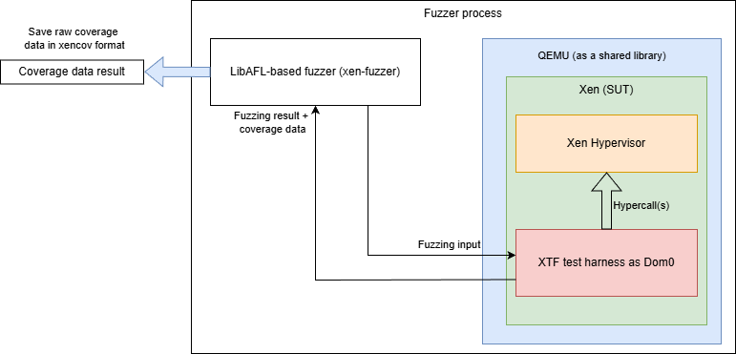
Coverage​
LibAFL can collect coverage data on machine instruction level using QEMUs own JIT translator (TCG). ​
But we use Xen's own coverage collection mechanism "xencov", both as fuzzer feedback and as metrics to evaluate fuzzing session.​

Slide 54
External MC/DC collection workflow
Analyze AST to find decisions and conditions, collect expression structure, variable names, code locations
Combine this data with DWARF information to identify binary code ranges that correspond to boolean expressions
Disassemble binary code and match it to structure of boolean expressions of interest
Use data from the previous step to generate list of PC locations (and corresponding auxiliary data) for QEMU plugin
QEMU plugin traces code execution, uses auxiliary data to determine result of each condition and provides tracing output
Separate tool analyzes trace to provide MC/DC report

Slide 55
Implementation nuances
Caveats
Pros
Requires binary to be built without any optimizations (-O0)
Will depend on compiler (we are focusing on Arm Compiler for Embedded, which is based on clang 22.1)
Cannot easily handle complex macros (TBH, GCC's own analyzer struggles with this as well)
Does not require code modification (except enabling compilation with -O0)
Should provide better results than LLVM's own MC/DC analyzer
Execution is traced externally: Software Under Test can't inadvertently alter counters due to subtle defects
Execution is traced externally: tracing data will be present even if SUT crashes

Slide 56
Binary code matching
Thanks to -O0, clang generates very predictable binary code structure:
Thanks to DWARF we can match variables (and cross-check code locations)
ac4: 385ef3a8 ldurb w8, [x29, #-17]
ac8: 37000148 tbnz w8, #0, af0 <main+0x38c>
acc: 14000001 b ad0 <main+0x36c>
ad0: 385ee3a8 ldurb w8, [x29, #-18]
ad4: 370000e8 tbnz w8, #0, af0 <main+0x38c>
ad8: 14000001 b adc <main+0x378>
Load variable ( 'a' from the previous slide)
Perform op + short circuit ( !a && ...)
Go to next sub-expression
Load variable ( 'b' from the previous slide example)
Perform op + short circuit ( !b && ...)
Go to next sub-expression
0x000001cc: DW_TAG_variable
DW_AT_location (DW_OP_fbreg -17)
DW_AT_name ("a")
DW_AT_decl_file ("test2.c")
DW_AT_decl_line (13)
DW_AT_type (0x00000228 "_Bool")
<= matches [x29, #-17] from disassembly
<= variable name

